Slide 1

Data Driven Wine Selection Selection Massale
Logan Hahn & Chidi Nzerem

Slide 2

Background
Quinta da Aveleda
Research Question
Selection Massale
Significance

Slide 3
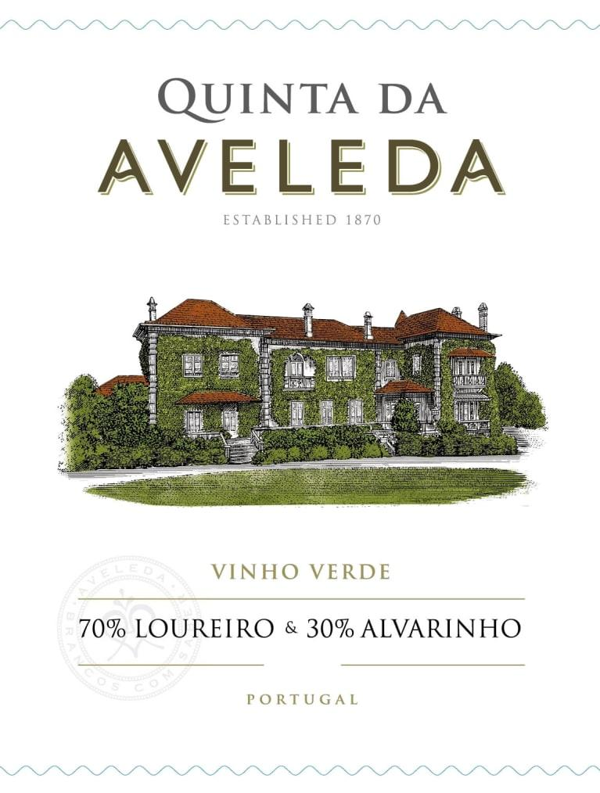
Quinta da Aveleda
Largest exporting wineries in the region of Vinho Verde
Family owned and operated
Made from a variety of Portugese grapes
Notes:
Tucked in the hills of Penafiel, Portugal, Quinta da Aveleda, is one of the largest exporting wineries in the Vinho Verde region. Family owned and operated since 1870, Aveleda is known for its architecture, heritage, and vast white wine selection. Made from a variety of different Portuguese grapes such as alvarinho, loureiro, azal, and avesso grapes, each wine brings a different taste of the region to the table. The wines developed in this winery don't age for long (only 3-9 months), tend to be low in alcoholic percentage, and have a slight fizz to it when you pop the cork of the bottle.

Slide 4
Research Question
Select showcase wines
Can we predict wine quality at Quinta da Aveleda using physicochemical characteristic data?
Must be a diverse selection
Notes:
The problem is that Quinta da Aveleda needs help determining which wines to showcase in their wine tasting. In order to do this, we need to determine at least 5 wines and make sure that there is a diverse palate. This diverse palate will include a variety of dry, medium dry, and medium sweet wines that have a different alcohol contents as well as different levels of pH, volatile acidity, and residual sugars.

Slide 5

Selection Massale
A French term for the replacement of underperforming wines with cuttings from the best vines in the vineyard
Replace predicted underperformers using Machine Learning
Notes:
Selection Massale is a vineyard management technique by which dead or under-performing vines are replaced with new vines grown from cuttings from many of the best older vines in the vineyard. maintaining both the vineyard’s health and diversity.
We are the team behind the scenes that is helping Quinta da Aveleda choose the best wines to showcase in their tasting. To do this, we will be predicting the wines quality rating (aka the rating given by the judges) and after doing that, we will take the top 100 from that list, and perform an integer optimization to see which wines Aveleda should showcase. So we will be narrowing it down to 6 to 12 wines.
In order to do this, we needed to make direct constraints that will help our optimization. We will have a fixed acidity of at least 4.5, a minimum of 8% and a maximum of 14% in alcohol content, and focus on the residual sugar levels.
Our main goal is to select a variety of different wines that meet a different criteria of the given parameters that we are looking into.

Slide 6
Significance
Exhibits how data analysis techniques can be deployed to solve problems in any industry
In the case of Quinta da Aveleda, choosing the best possible wines for their showroom
Notes:
The problem is that Quinta da Aveleda needs help determining which wines to showcase in their wine tasting. In order to do this, we need to determine at least 5 wines and make sure that there is a diverse palate. This diverse palate will include a variety of dry, medium dry, and medium sweet wines that have a different alcohol contents as well as different levels of pH, volatile acidity, and residual sugars.

Slide 7
Data Understanding & Preparation
The Data
Data Preparation

Slide 8
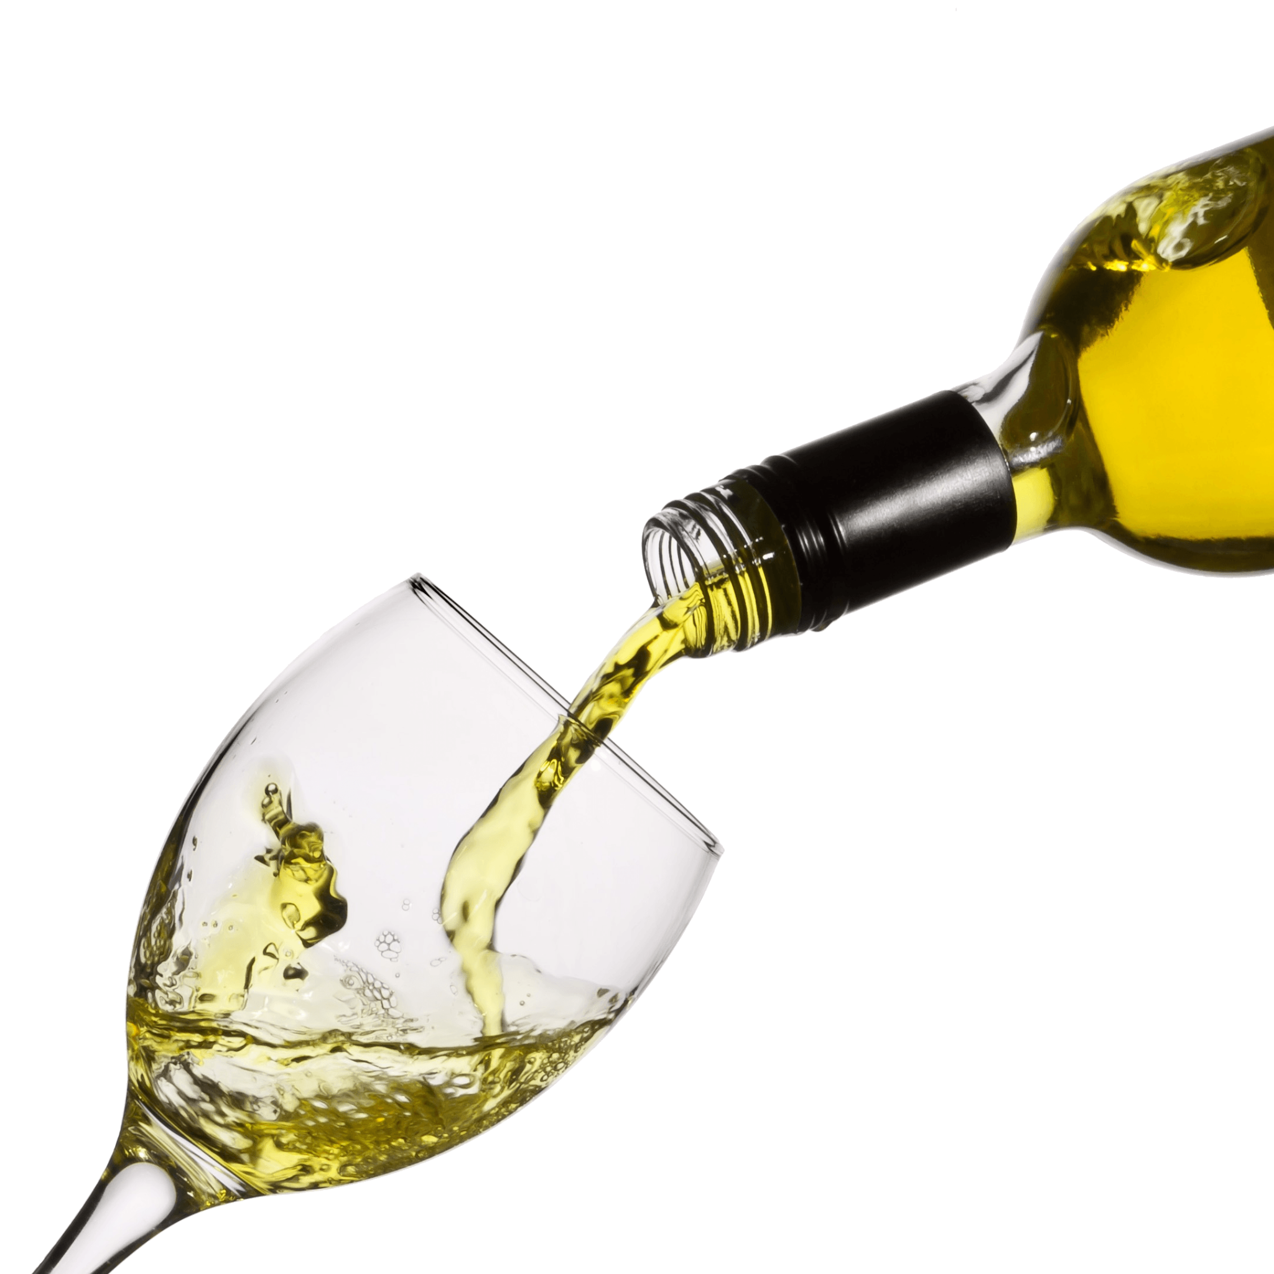
The Data
Shape (4,898 rows, 12 variables)
Variables:
Fixed acidity, volatile acidity, citric acid, residual sugar, chlorides, free sulfur dioxide, total sulfur dioxide, density, pH, sulphates, alcohol and quality
Predicting Quality
Notes:
The data consists of 4,898 rows with 12 different variables. All of the columns are continuous numeric columns, which was nice because there wasn’t a ton of data cleaning that needed to be done.
Since 2014, Portugal has seen a 5% increase in their exportation of wine with the top distributor being the Vinho Verde region. The data used for this assignment came from a set of researchers in the Vinho Verde region, who collected data on the main components of white wines as well as their overall quality. For this project, we will be acting as a team from the Quinta da Aveleda winery, using the dataset to predict the rating of a wine before its release based on physicochemical characteristics recorded during production. The dataset that was provided by the researchers in the Vinho Verde region had 11 different numeric input features that are based on the physicochemical tests, and a factor output variable of Quality (Wine Certification) that is determined of a score between 1-10 with the highest score being seven and the lowest score being one.
“Wine certification is generally assessed by physicochemical and sensory tests. Physicochemical laboratory tests routinely used to characterize wine include determination of density, alcohol or pH values, while sensory tests rely mainly on human experts. It should be stressed that taste is the least understood of the human senses thus wine classification is a difficult task..” - (Cortez)

Slide 9
Data Preparation
Cleaning
Column Names
Null Values
Quality Column
Notes:
For data cleaning, we needed to make very little changes as the data was fairly clean. All that we needed to do was assign each column with which variable it was as it was originally listed as V1, V2, V3, etc. Then remove null values. One part that we lucked out on was the fact that all of the data were continuous, numeric values so the data type didn’t need to be changed.

Slide 10
Data Visualization & Modeling
Development and Improvement
Training, Testing
Linear Regression
Evaluation

Slide 11
Model Development and Improvement
Started with decision trees
Moved to regression
Removed variables based on significance
Removed highly correlated variables based on VIF score
Tested with interaction terms
Tested with interaction terms & data transformations
Notes:
When we began modeling, we first looked at using decision trees and briefly looked at a logistic regression but decided that a linear regression model was the best option as we could create a model that predicted the continuous value of the quality of wines.
We started by running a model with Quality as the target variable and all variables in the dataset as explanatory variables. From here, we removed all insignificant variables based on their respective p-value and ended up removing 3 variables citric_acid, chlorides, and total sulfur dioxide.
After removing these variables, we wanted to look at the colinearity of each variable in order to avoid undermining the statistical significance of each independent variable and having instability in our regression. We used the variance inflation factor score on the model and set a threshold maximum of 10, therefore removing the variables whos VIF score was greater than or equal to ten which happened to be residual sugar and density.
At this point our model had an adjusted R2 of 25.72%. In order to improve the models fit, we tested and added interaction terms between the remaining variables. Bit by bit we were able to improve the score and included the interactions that had a statistically significant effect in the model.
From here, we wanted to improve the model even further so we wanted to look at the effect of data transformation terms to the model. None of the remaining variables had a high skew level, so we did not find it necessary to add any log transformations to the model. However, earlier when we were inspecting our data, we looked at the linearity of each independent variable with Quality. We noticed that some of the variables did not have a fully linear relationship with Quality. In order to more accurately capture the effect of each variable, we added quadratic terms of each variable to the model. We found that 3 of the quadratic terms were statistically significant, alcohol, fixed acidity, and free sulfur dioxide. After training and testing the model with the remaining significant variables, interactions, and quadratic terms, we found that the model’s overall fit had improved and we had found our best model.
We then scraped off the top 200 prediction scores and passed them on to the optimization model

Slide 12
Training and Testing
70% Trained: 3429 Wines
30% Tested: 1469 Wines
Notes:
The distribution of the Test set Quality is below.

Slide 13
Linear Regression
Best fitting model
Linear Regression with interaction and quadratic terms
Fixed acidity, volatile acidity, free sulfur dioxide, alcohol
R Squared: 31.35%
RMSE: 0.7994
Notes:
interactions
alcohol*fixed_acidity
alcohol*volatile_acidity
alcohol*free_sulfur_dioxide
added quadratic terms. The quadratic terms were added to improve the overall fit of the model. When observing the linearity of each variable, there was evidence of some of the variables not having a fully linear relationship with the dependent variable
fixed_acidity
free_sulfur_dioxide
alcohol
no significant change in RMSE from the quadratic
to evaluate the model we looked at the Multiple R-squared value, 0.3155, and the Adjusted R-Squared value, 0.3135. This means that 31 percent of the variation in Quality can be explained by our model’s independent variables.
The RMSE continually increased in our tested models after removing the variables with high collinearity. Despite the chosen model having the highest RMSE out of all of our tested models, it is still the best fitting model because it is not undermining the statistical significance of the independent variables and has the strongest relationship with the dependent variable

Slide 14
Linear Regression R-Squared/RMSE
*Average Quality of Test Set: 3.88
Metric | With Significant Variables | Removed Highly Correlated Variables | Interactions | Interactions & Quadratic Variables
Adjusted R-Squared | 28.51% | 25.72% | 27.72% | 31.35%
RMSE | 0.7581 | 0.7675 | 0.7593 | 0.7994

Slide 15
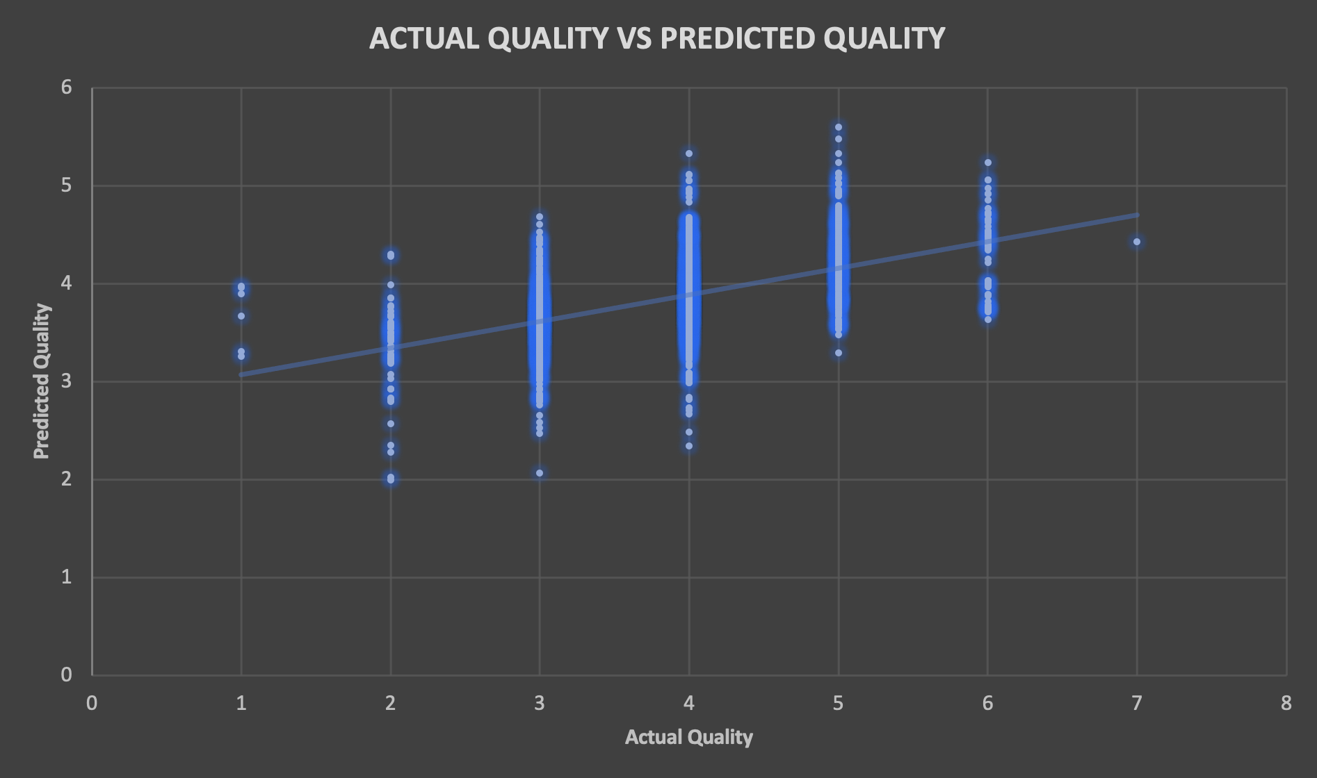
Predicted vs Actual Quality

Slide 16
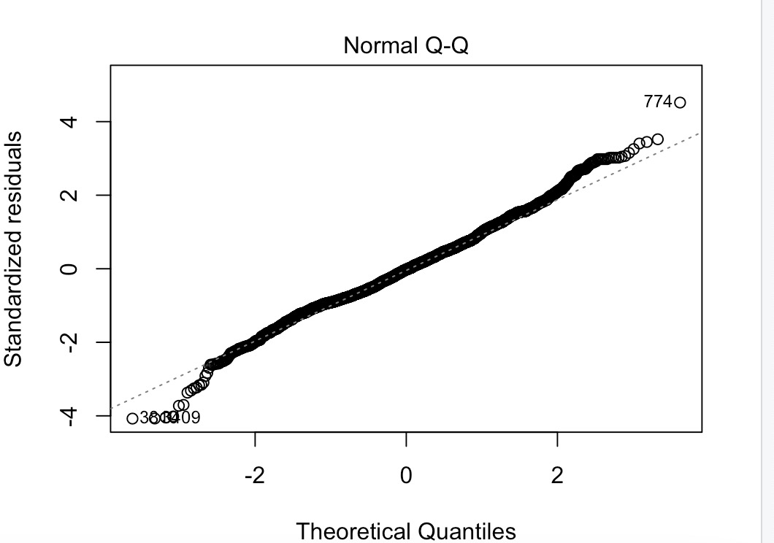
Observations

Slide 17
Conclusion
100 Wines selected from Linear Regression
Use excel optimization to select top 11 wines to use during showcase

Slide 18

THANK YOU

